Slide 1
Earth trekker ®
Your Travel Bucket List app ☺
By Michal Marszalek

Slide 2

Introduction
The purpose of my app is to track cities and countries the user visited and/or plans to visit.

Slide 3
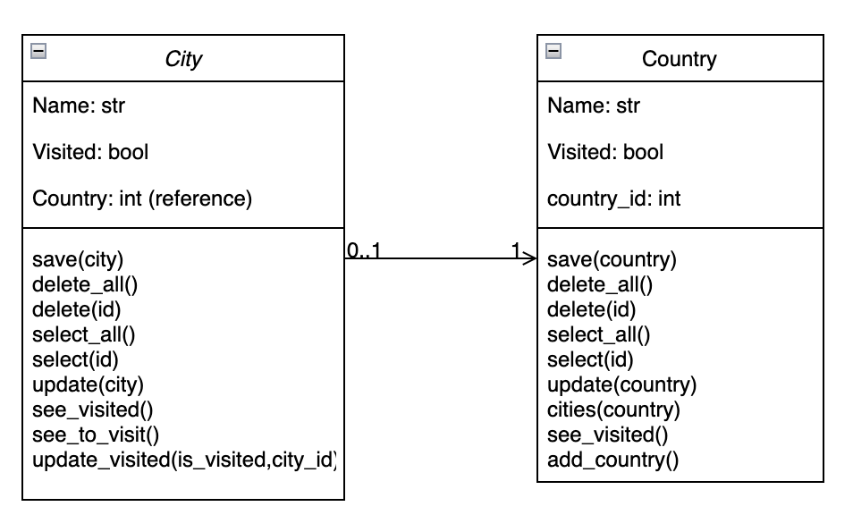
Models:

Slide 4
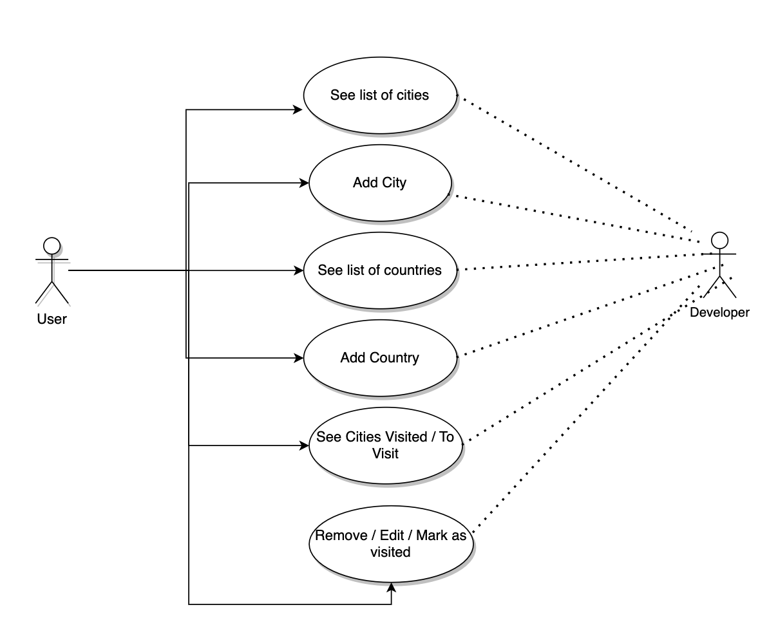
Use case diagram

Slide 5
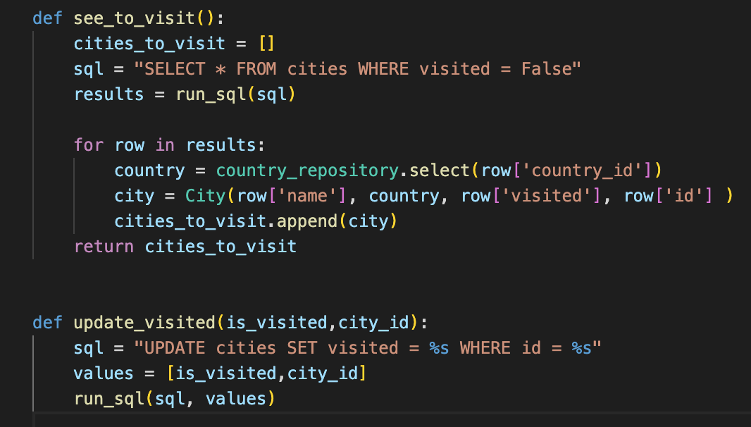
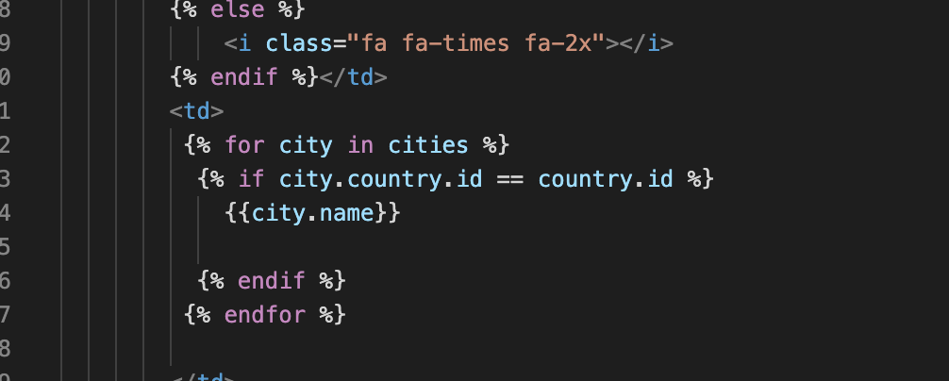
Some functions and jinja code I had problems with! (I was overcomplicating things…)

Slide 6
STAY TUNED FOR ACTUAL APP PRESENTATION ☺

